Slide 1
Oil Spill: Image Detection using Deep Learning Techniques and Statistical Analysis with ML Algorithms
DATA 695: Capstone Project
Group 5:
Md Nazmus Sajid
Jannatul Naeema

Slide 2
Introduction
Oil spills are catastrophic events
Health risk for people living nearby
Environmental damage to ecosystems and wildlife
Sources
Pipeline leaks and ruptures due to corrosion, mechanical damage or operational error
Offshore drilling: well blowout or equipment failure
Accident or collision of tanker or ships
Oil spill at oil refinery and storage facilities during storage, handling and transportation
Natural disaster: damages caused by hurricane, earthquake or storms

Slide 3

Objectives
Image Detection through Convolutional Neural Network.
Statistical analysis to find the best Machine Learning models to detect the important components responsible for oil spill.

Slide 4
Datasets
Dataset 1: Oil Pipeline Accidents ⁽¹⁾
Oil pipeline leak or spill documented by the DOT's Pipeline and Hazardous Materials Safety Administration.
Onshore and Offshore Pipelines Incidents.
2010 to 2017 across various states in the US.
48 columns and 2795 rows.
Dataset 2: Oil Spill Detection ⁽²⁾
Images of oil spill at sites in the Niger Delta region of Nigeria.
Almost 400 labelled images as No Spill and Oil spill.

Slide 5
Research Questions
Which independent variables are the most important to predict Liquid ignition and explosion. Also, the variables impacted to predict total financial loss.
Which Statistical model best predicts Liquid ignition, Liquid explosion and All Costs in terms of mean squared error (MSE) and F1 score.
How precisely the neural network model can predict whether there would be an oil spill or not through images.

Slide 6
Part 1: Image Classification using Dataset-2 (Images)

Slide 7
Loading of Data
Load data using ‘image_dataset_from_directory’ function from the ‘tf.keras.utils’ module from TensorFlow. Then we have loaded our images in a variable known as ‘data’ which configures the directory into two classes:
Spill images
No Spill images
Next, the ‘data_iterator’ is created by calling the ‘as_numpy_iterator’ method on the ‘tf.data.Dataset’ object called ‘data’.

Slide 8
Data Pre-Processing
Lambda function takes the input in the form of x and y where x represents the input images and y represents the corresponding labels.
Dividing the images by 255 is to scale the pixel values from the original range of 0-255 to a normalized range of 0-1.

Slide 9
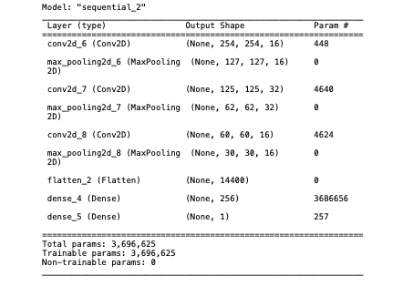
Building the CNN model(1)
Convolutional Neural Network Architecture

Slide 10
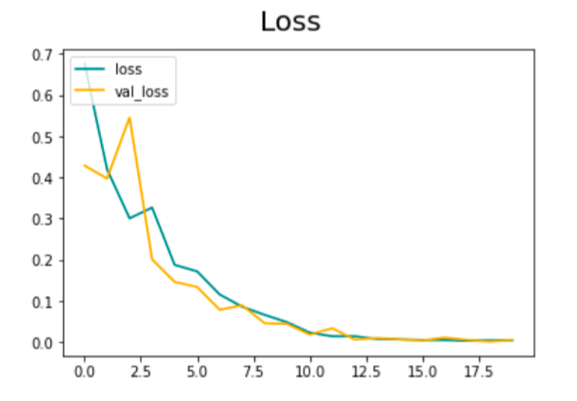
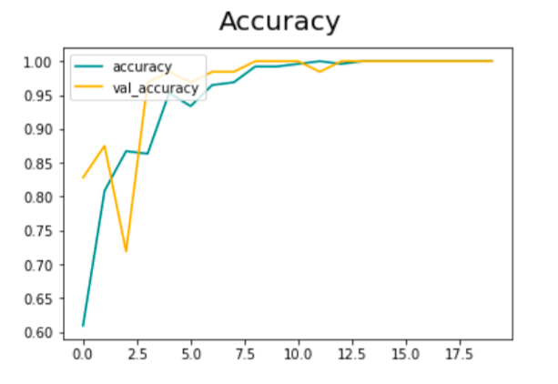
Building the CNN model(2)
The training and validation loss values over the epochs
The training and validation accuracy values over the epochs

Slide 11
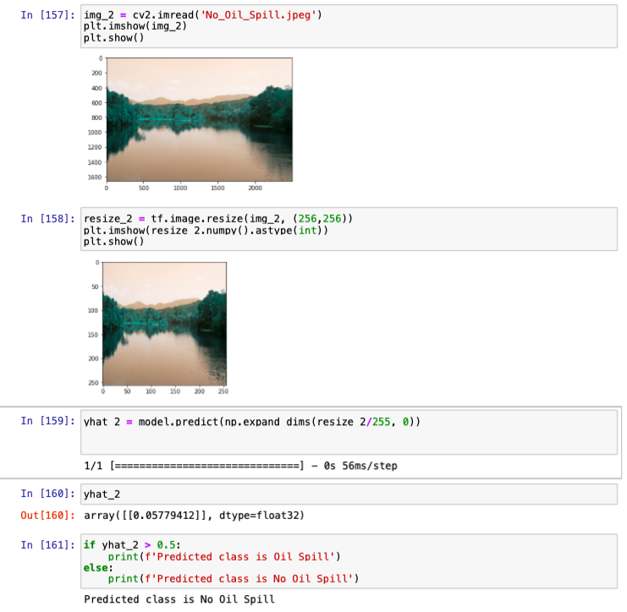
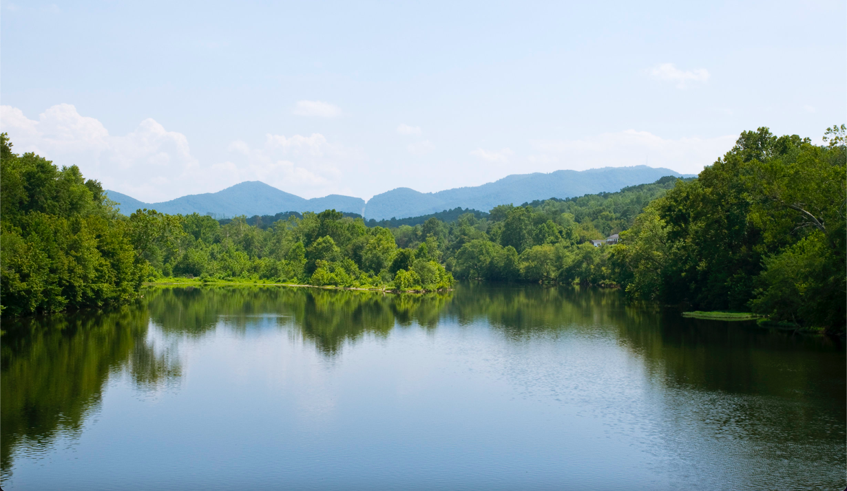
Evaluation of the model
Original Image
CNN model predicting no oil spill

Slide 12
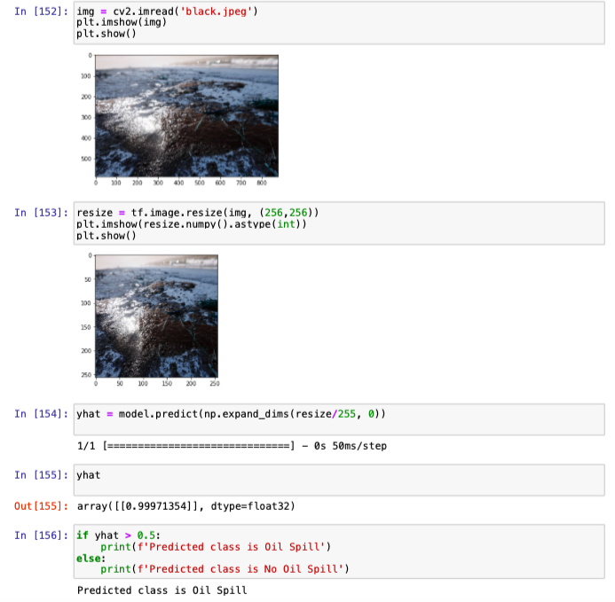
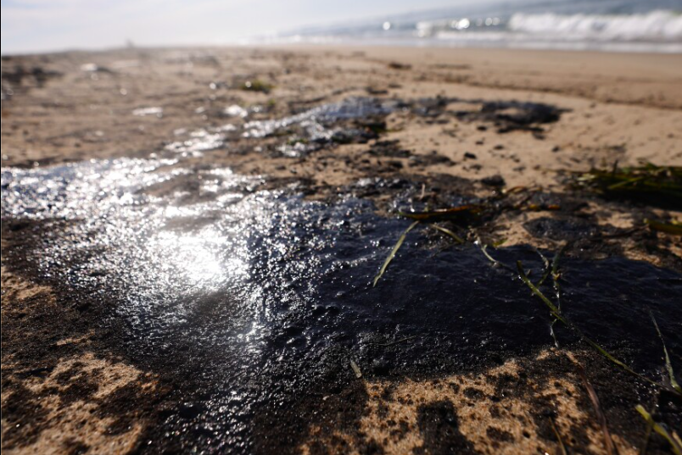
Evaluation of the model
Original Image
CNN model predicting oil spill

Slide 13
Part 2: Statistical Analysis with ML Algorithms using Dataset-1

Slide 14
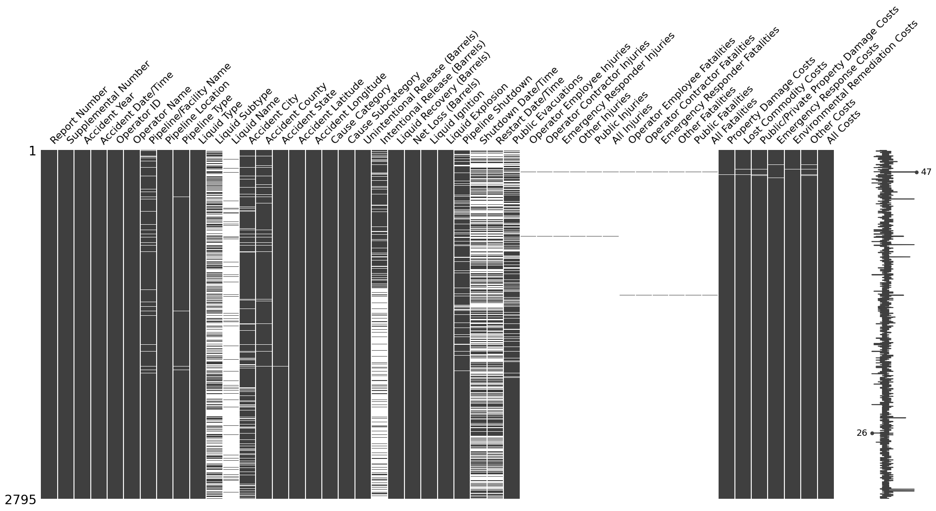

Data cleaning and Wrangling
Both categorical and numerical variables are available
Checked for any missing value
Dropped few columns
Replace missing value with appropriate NaN, NO, 0 where applicable
Checking for missing value

Slide 15
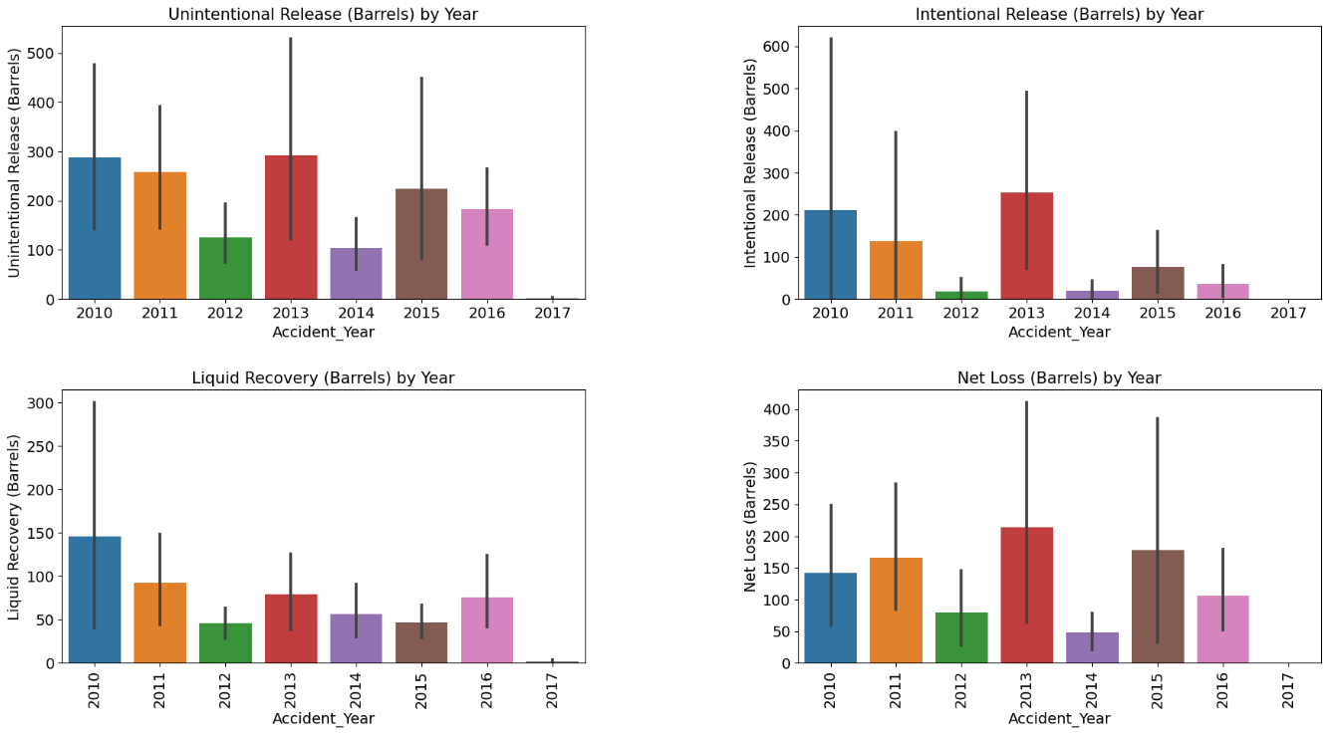
Exploratory Data Analysis and Visualization

Slide 16
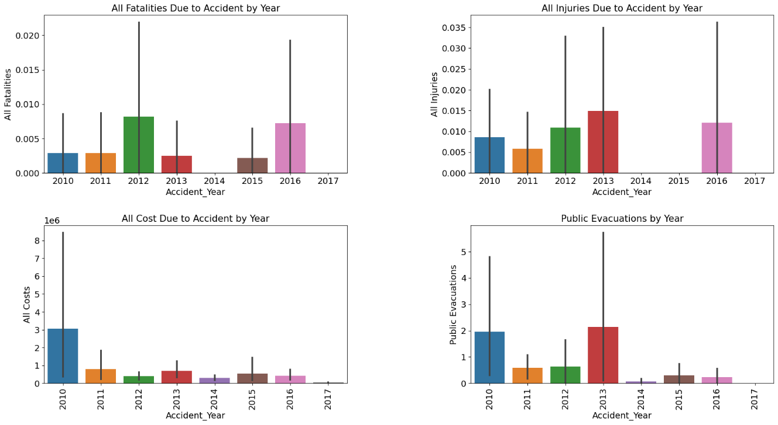
Exploratory Data Analysis and Visualization (cont’d)

Slide 17
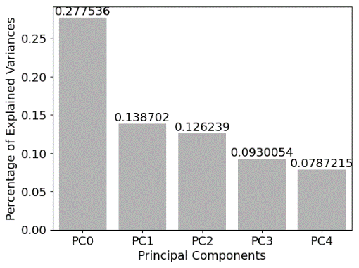
Principal Component Analysis (PCA)
We aimed to reduce dimensionality to 5
But the results showed that only 27.7% of the variables were explained by PC1, and 13.87% were explained by PC2, 12.6% by PC3, 9.3% by PC4 and 7.9% by PC5
Total of 71.36% of the variables were explained by the five principal components

Slide 18
Classification
Target Variables
Liquid Explosion
NO
YES
Liquid Ignition
YES
NO
Pipeline Shutdown
YES
NO

Slide 19
Types of Classification Applied
Logistic Regression
Decision Trees for Classification
Random Forests
Naive Bayes

Slide 20
Logistic Regression
Predictor variables for Logistic Regression model:
Pipeline Type
Liquid Type
Liquid Subtype
Liquid Name
Accident State
Accident Latitude
Accident Longitude
Cause Category
Unintentional Release(Barrels)
Intentional Barrels(Barrels)
Liquid Recovery(Barrels)
Net Loss(Barrels)
Liquid Ignition
Target Variable for the model is Liquid Explosion

Slide 21
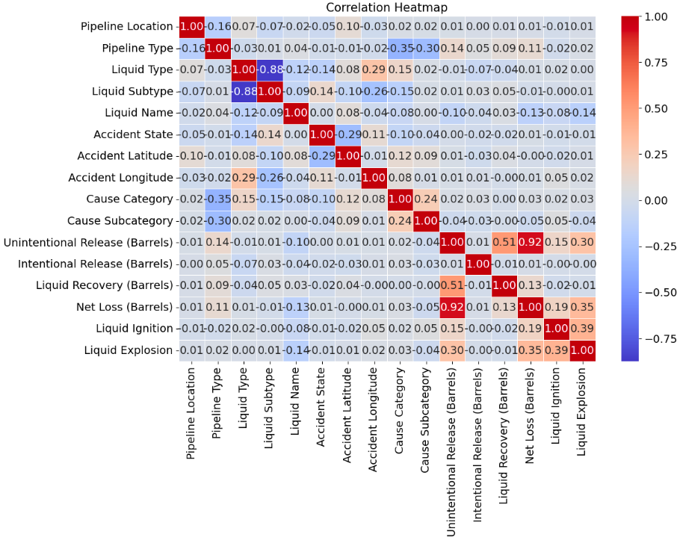
Logistic Regression
Correlation Matrix between the variables

Slide 22
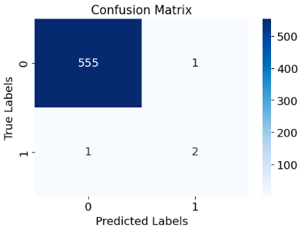
Logistic Regression Evaluation of the model
Best Hyperparameters from Grid Serach CV : {'C' : 10 , 'penalty': 'L1', 'solver': 'liblinear'}
Confusion Matrix between True and Predicted Values

Slide 23
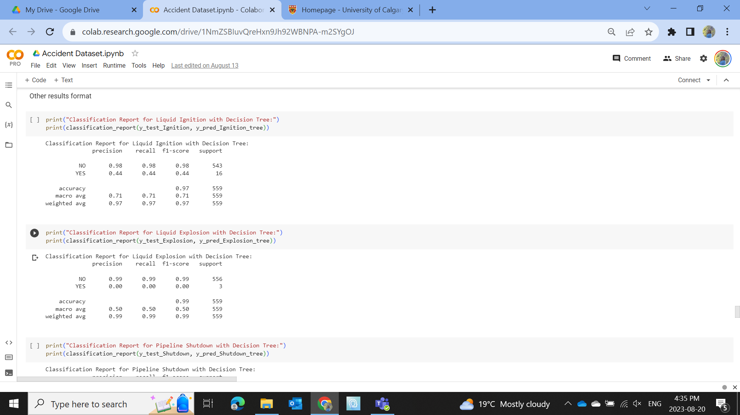
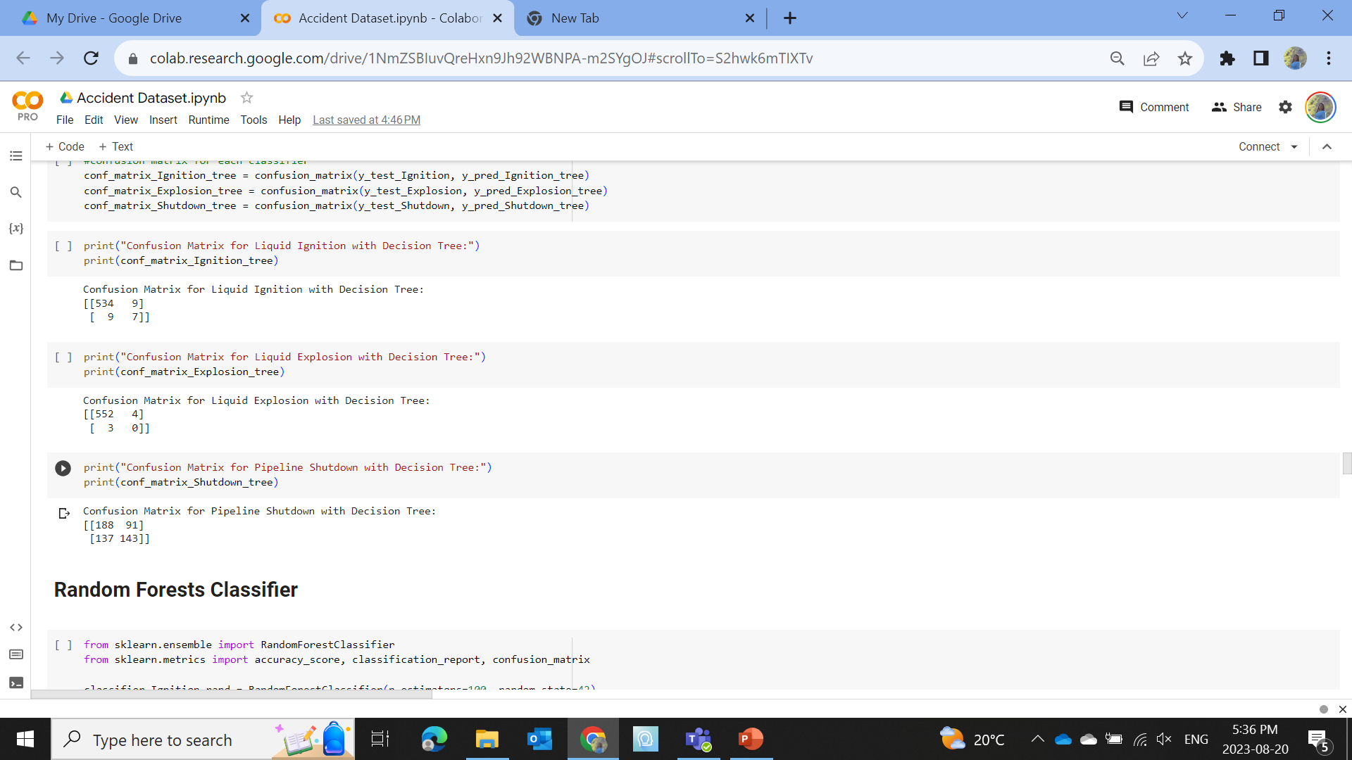
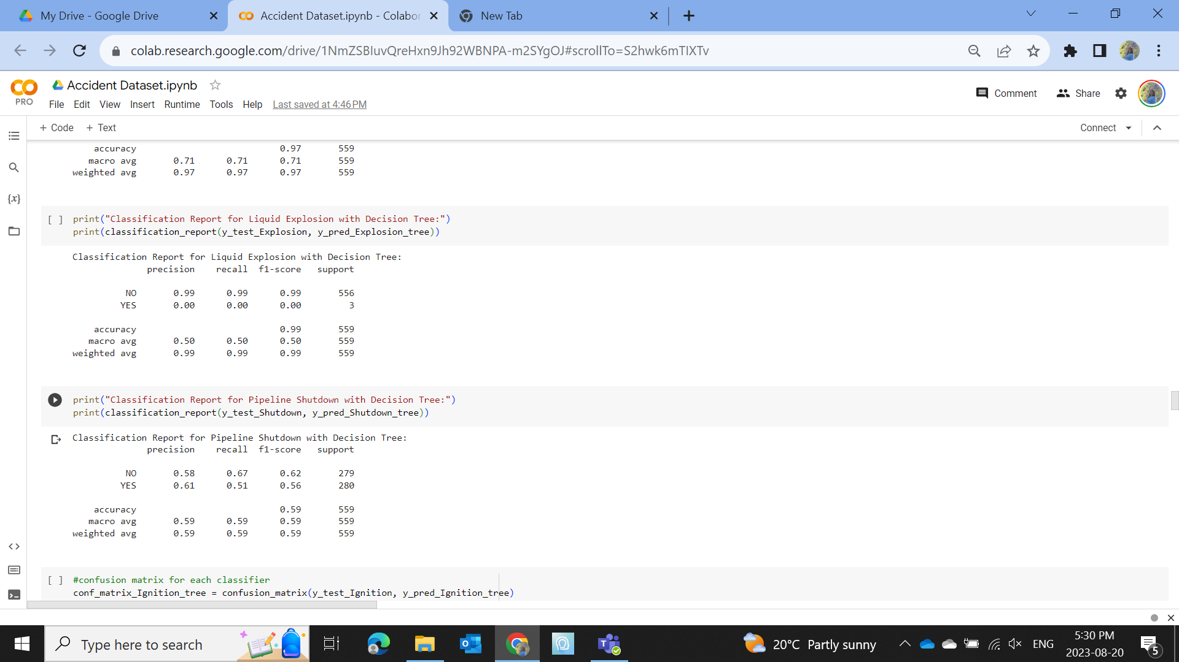
Decision Trees for Classification

Slide 24
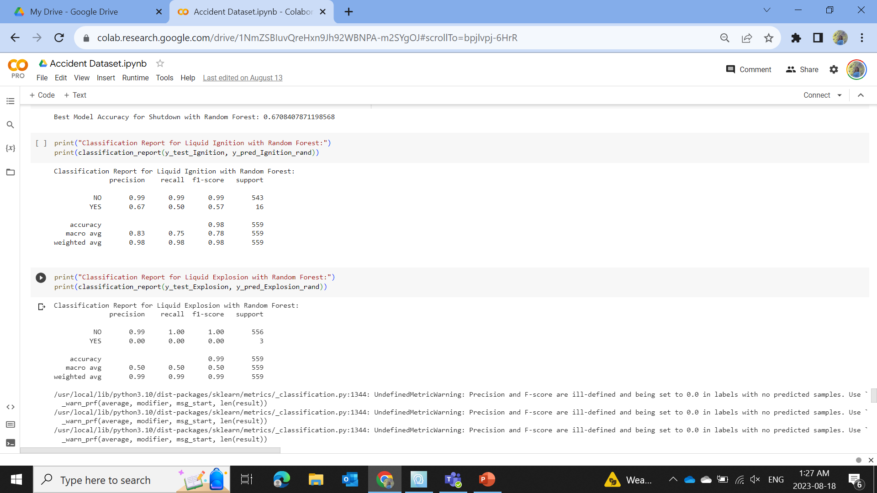
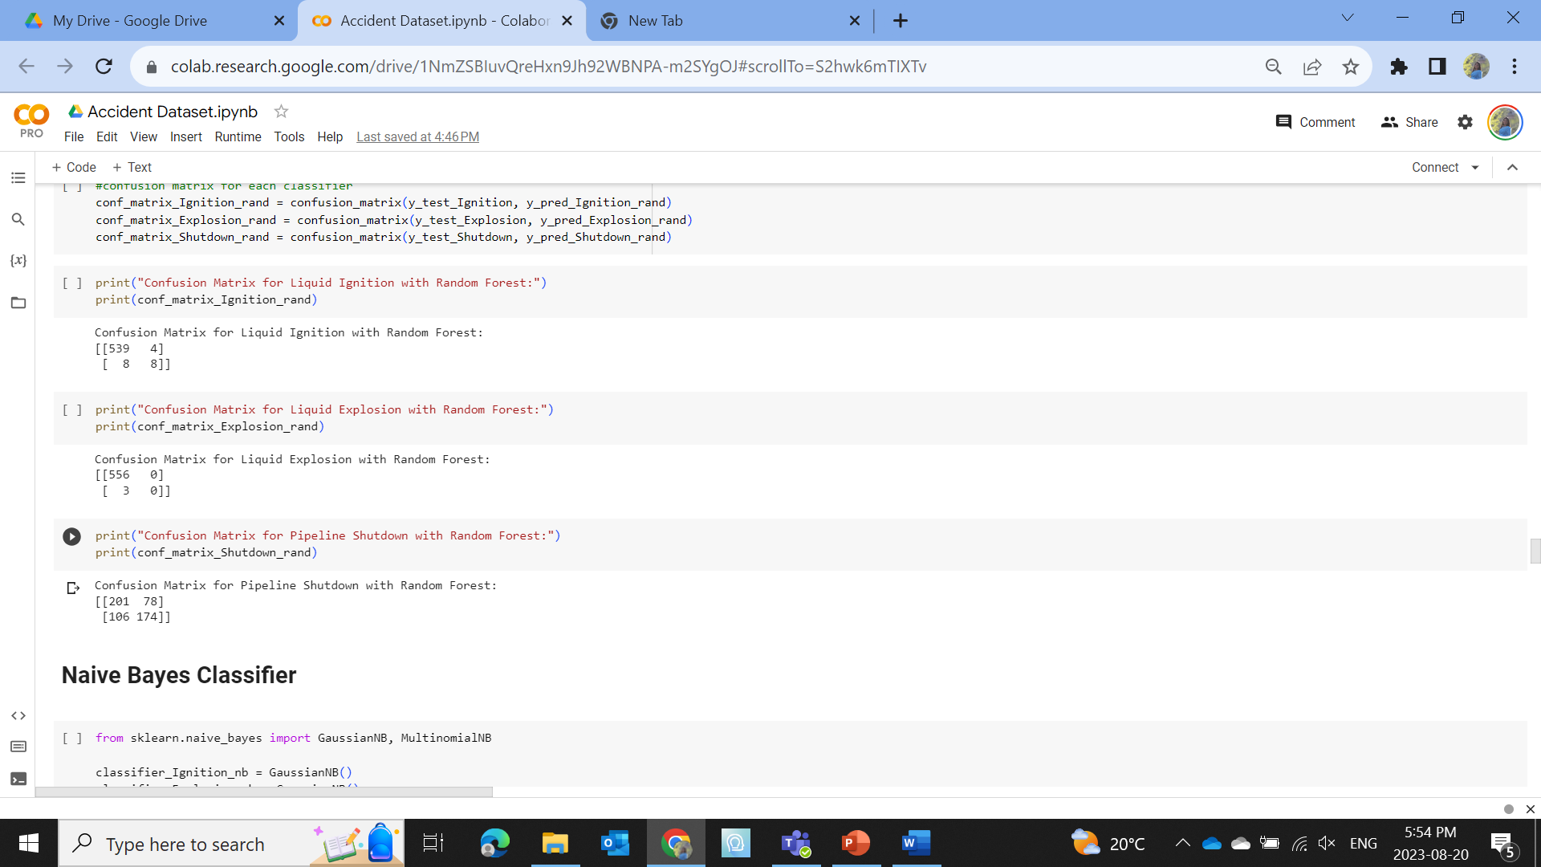
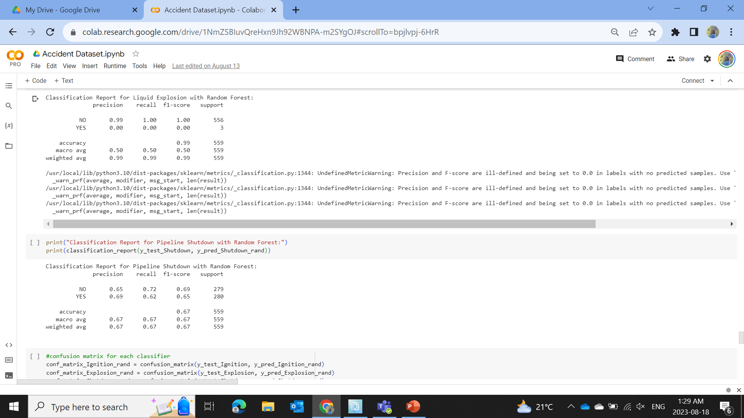
Random Forests Classifier

Slide 25
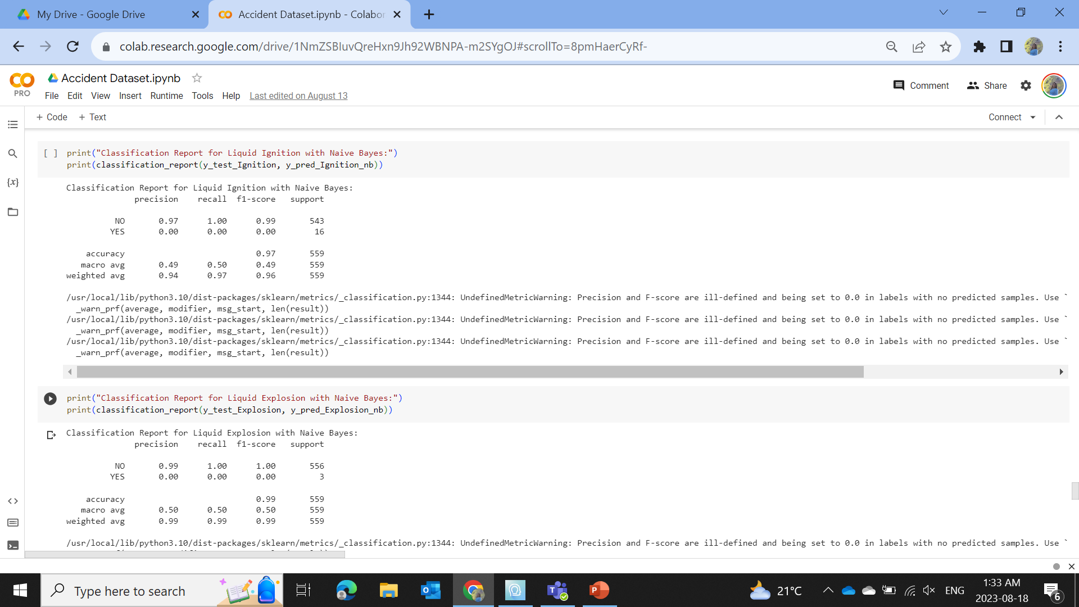
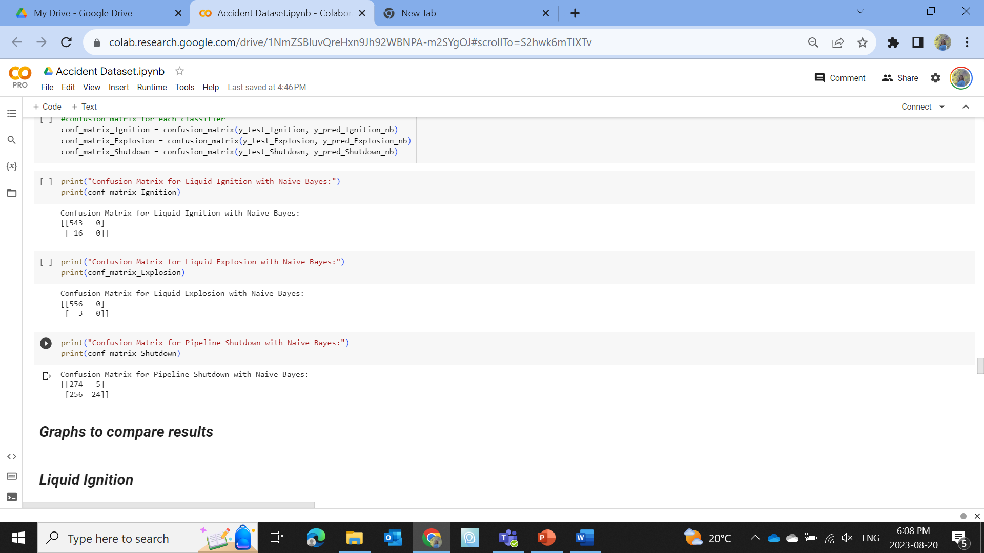
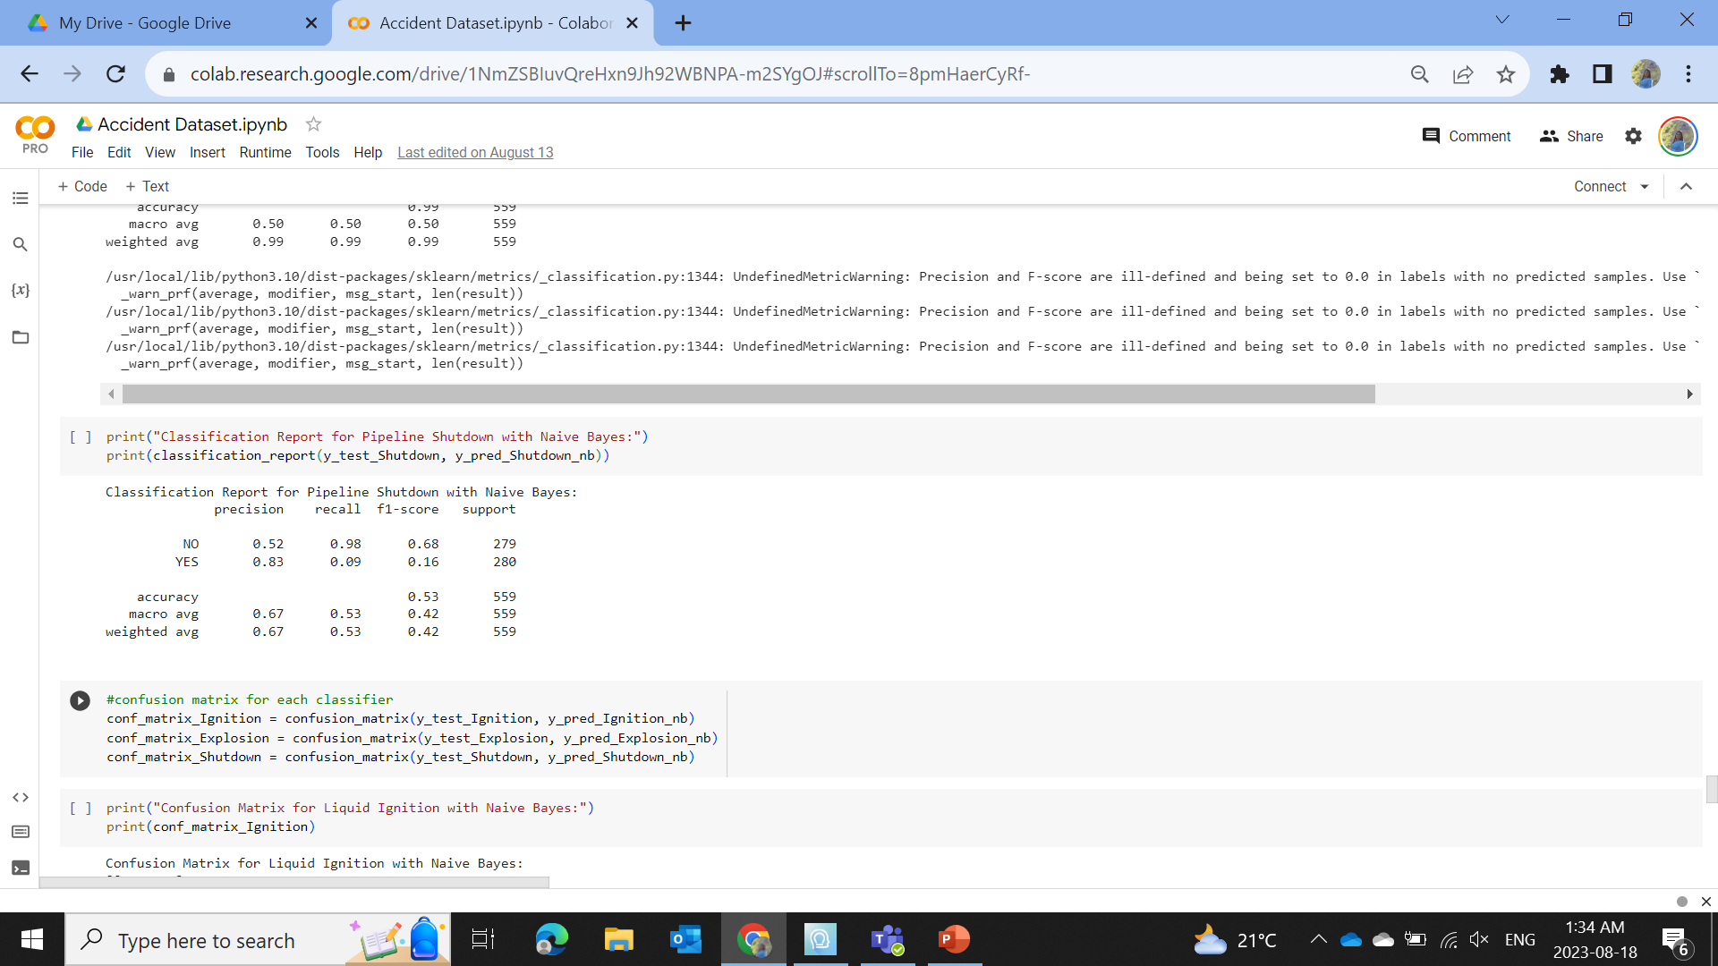
Naive Bayes for Classification

Slide 26
Best Hyperparameters for Different Classification Models
 | Best Hyperparameters for three different Target Variables with Different Classifications
 | Liquid Ignition | Liquid Explosion | Pipeline Shutdown
Decision Trees | criterion: gini, max_depth: 10, min_samples_leaf: 2, min_samples_split: 10 | criterion: entropy, max_depth: None, min_samples_leaf: 2, min_samples_split: 2 | criterion: entropy, max_depth: 10, min_samples_leaf: 2, min_samples_split: 10
Random Forests Classifier | criterion: entropy, max_depth: 15, min_samples_leaf: 1, min_samples_split: 2, n_estimators: 100 | criterion: gini, max_depth: None, min_samples_leaf: 1, min_samples_split: 5, n_estimators: 100 | criterion: entropy, max_depth: 15, min_samples_leaf: 2, min_samples_split: 10, n_estimators: 200
Naive Bayes Classifier | var_smoothing: 1e-05 | var_smoothing: 1e-05 | var_smoothing: 1e-08

Slide 27
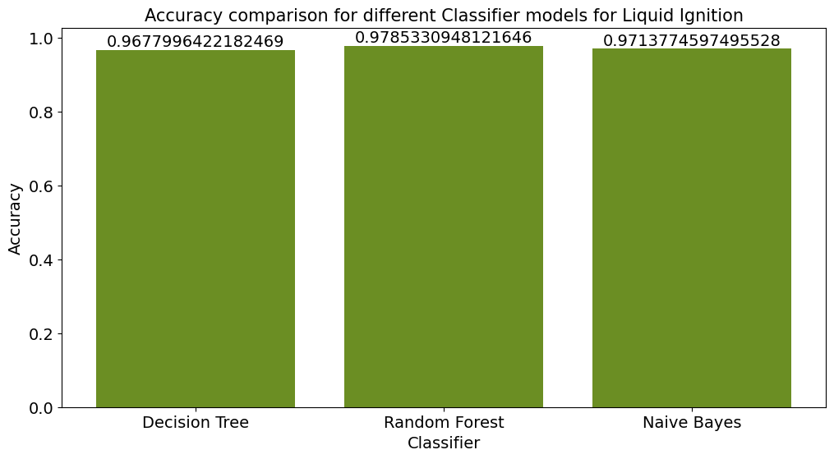
Results and Discussion for Classification
For Liquid Ignition, Random Forest Classifier has the highest accuracy

Slide 28
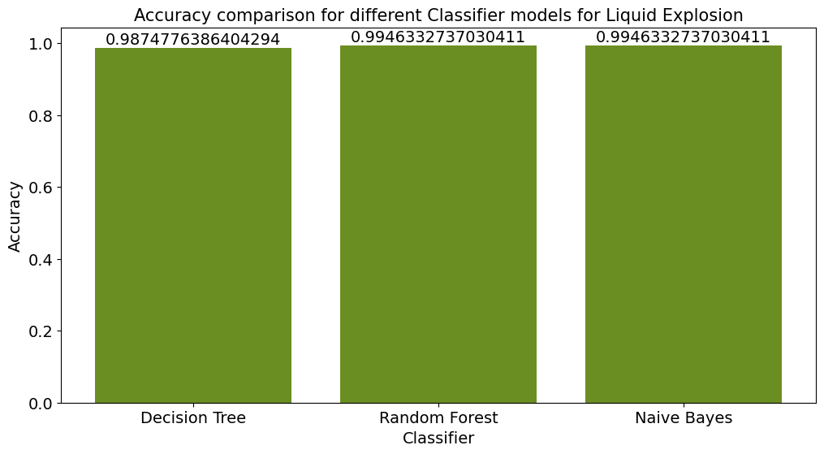
Results and Discussion for Classification
To classify the category of Liquid Explosion, Random Forest Classifier has the highest accuracy

Slide 29
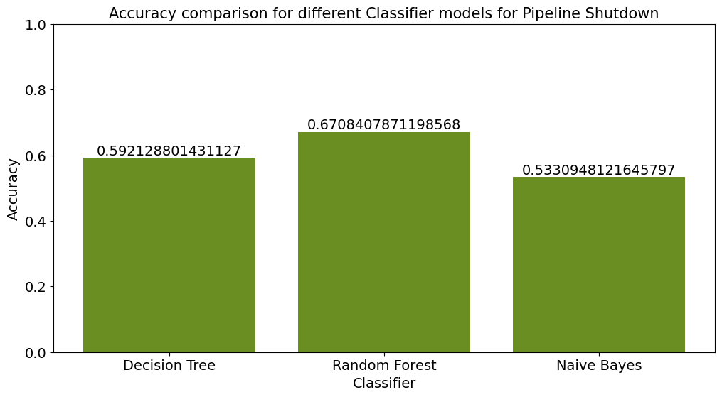
Results and Discussion from Classification
For the Pipeline Shutdown classification, Random Forest Classifier has the highest accuracy

Slide 30
Features Selection
Implementation of decision trees
The most important features
To classify the three target variables
Liquid Explosion, Liquid Ignition and Pipeline Shutdown

Slide 31
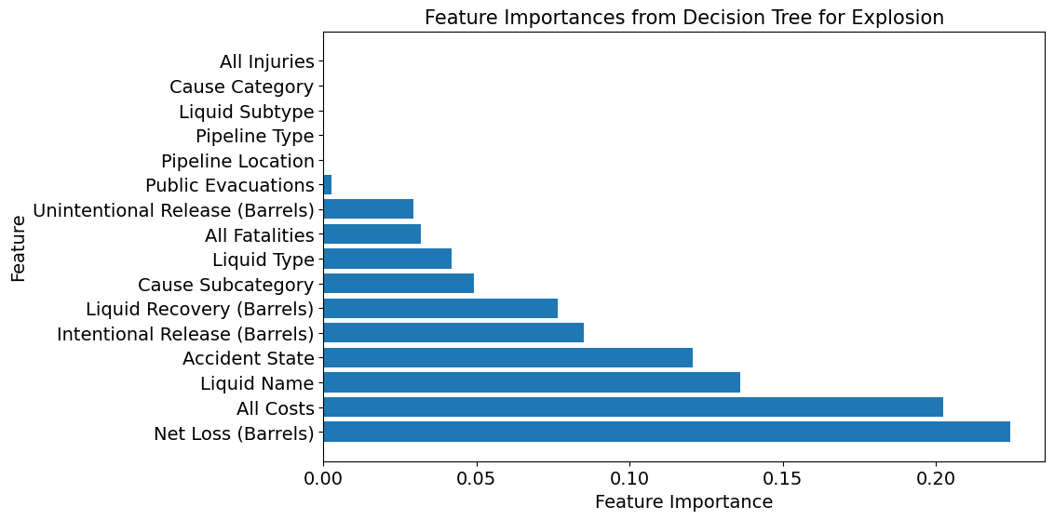
Results and Discussion for Feature Selection
For liquid explosion, the most important features are Net Loss of liquid (Barrels) and All cost incurred due to spill

Slide 32
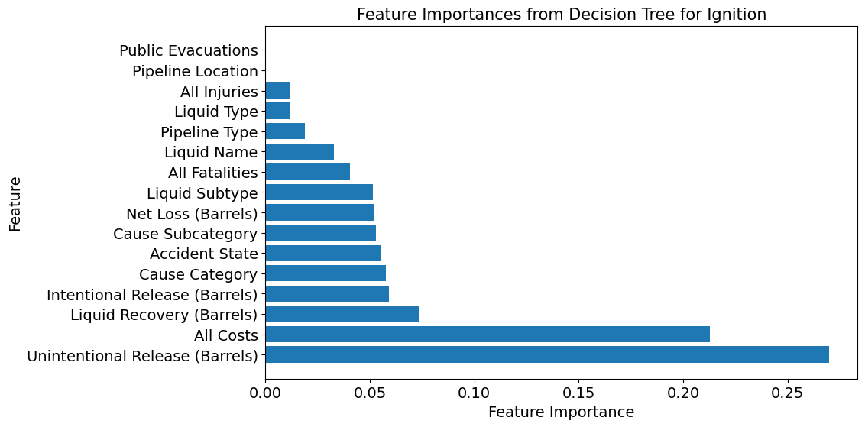
Results and Discussion for Feature Selection
For liquid ignition, the most important features are Unintentional Release of liquid (Barrels) and All cost incurred due to spill

Slide 33
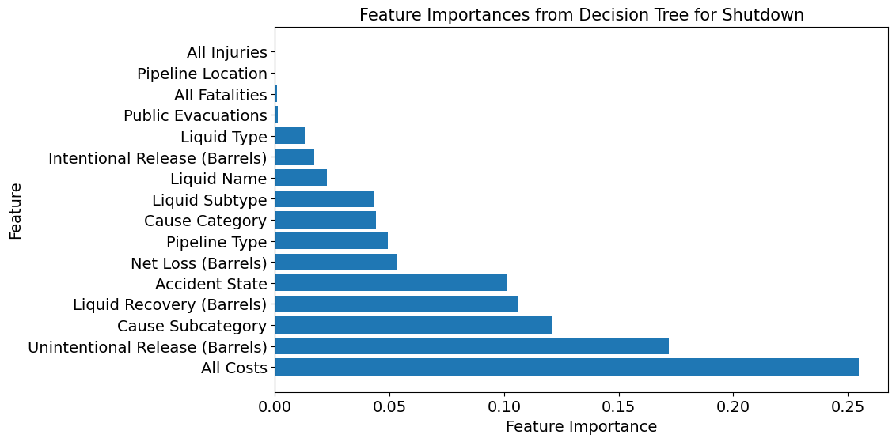
Results and Discussion for Feature Selection
For Pipeline Shutdown, the most important features are Unintentional Release of liquid (Barrels) and All cost incurred due to spill

Slide 34
Regression Models
Target Variables
Liquid Recovery
Unintentional Release
All Costs due to Accidents

Slide 35
Types of Regression Models
Linear Regression
KNN
Random Forest
XGBoost
AdaBoost

Slide 36
Linear Regression
We checked for the following assumptions:
Residual Plot
Multicollinearity with variance inflation factor(VIF) and Eigenvalues
But the assumptions were not met, so we decided not to perform linear regression

Slide 37
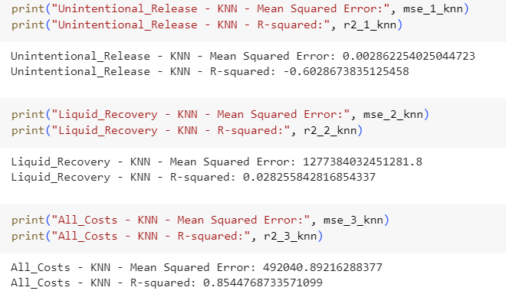
KNN

Slide 38
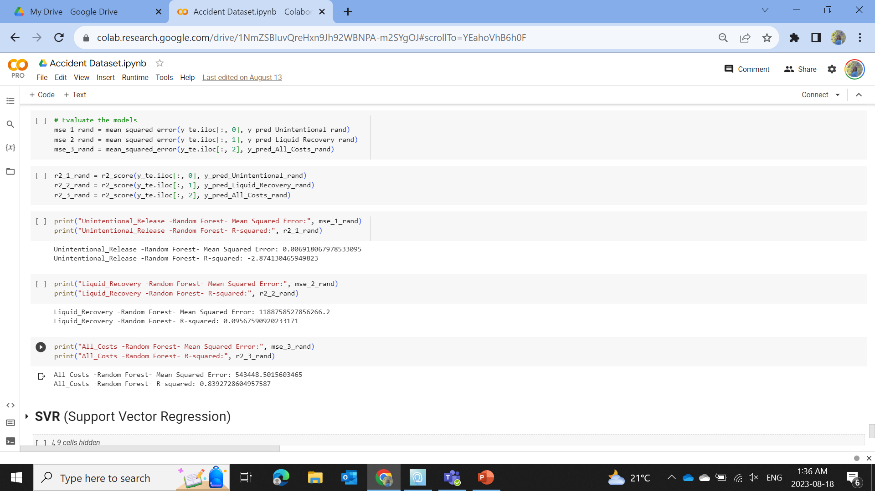
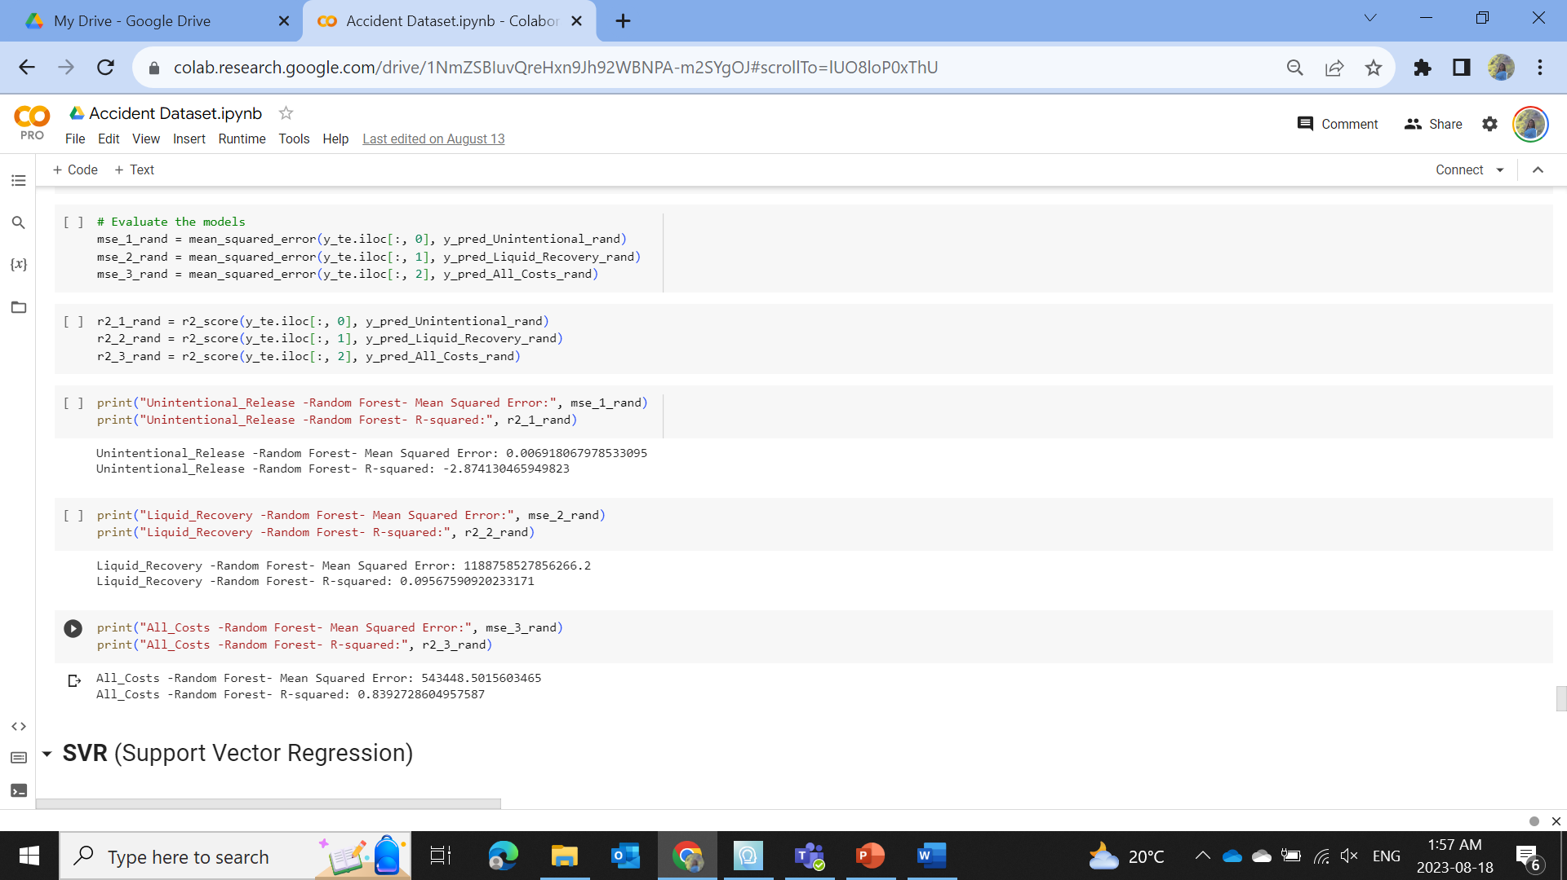
Random Forest

Slide 39
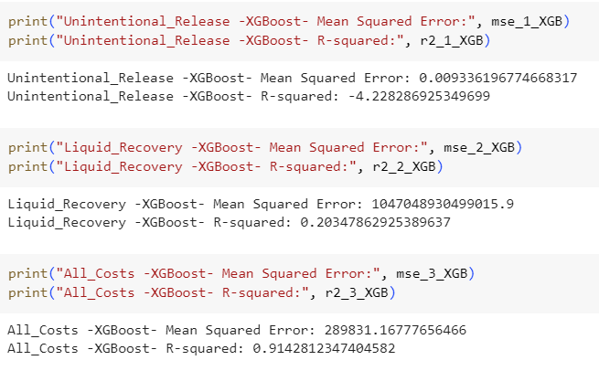
XGBoost

Slide 40
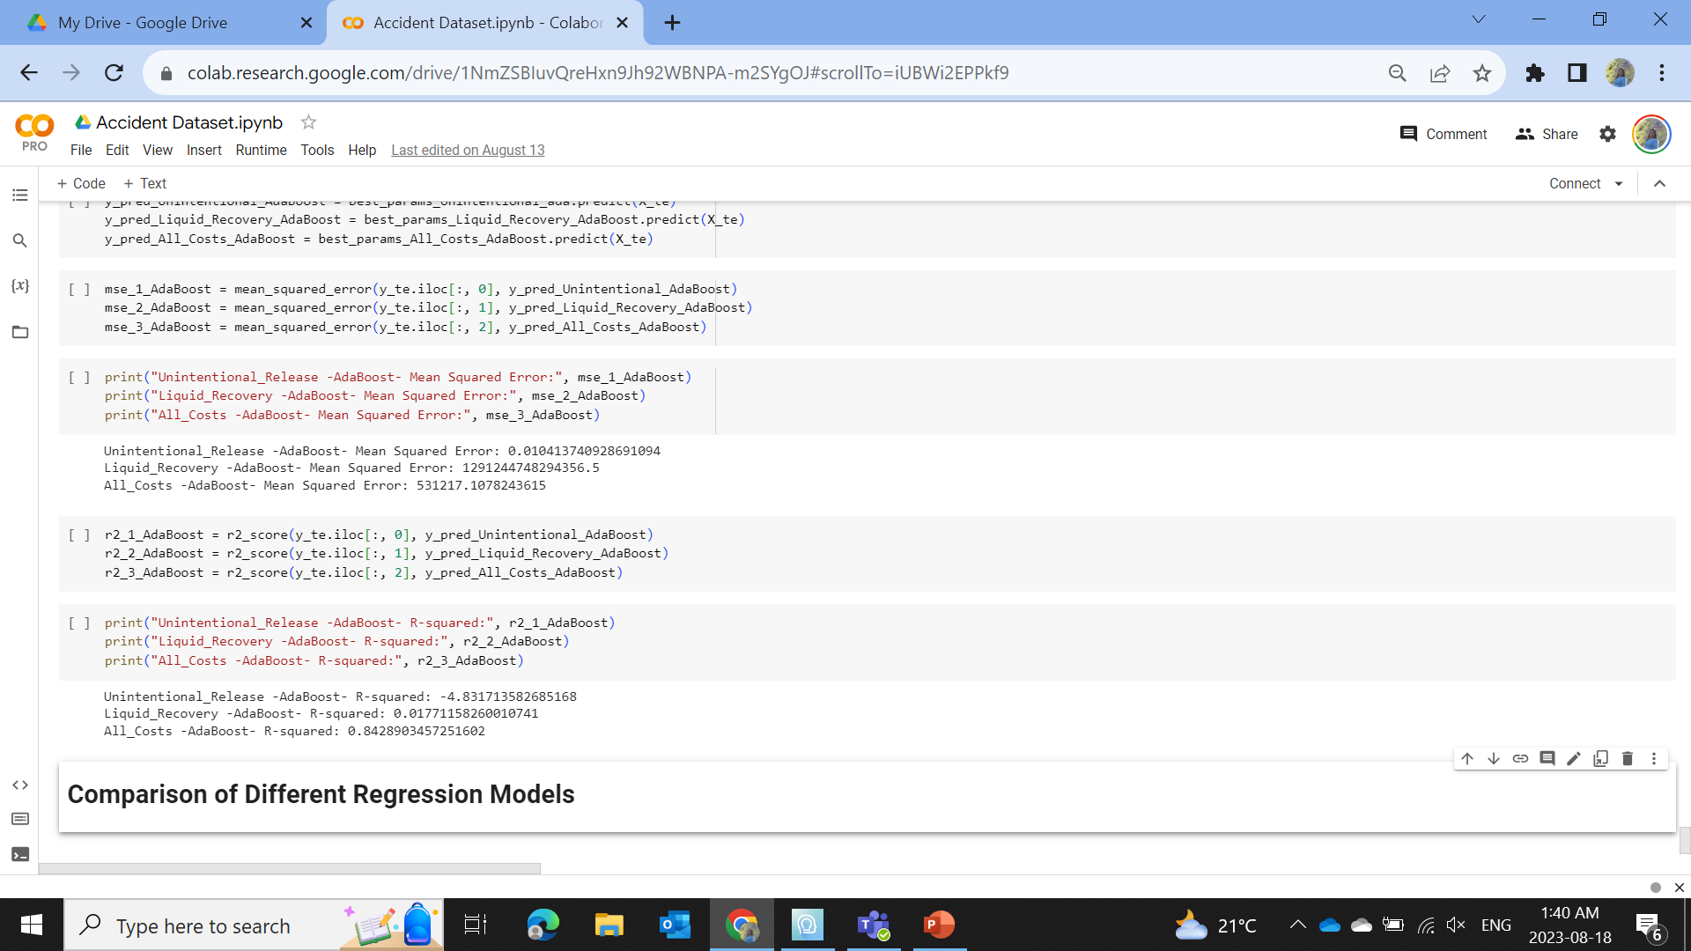
AdaBoost

Slide 41
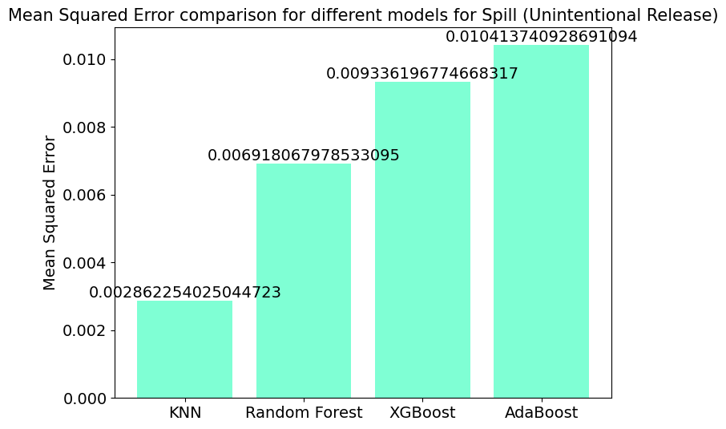
Results and Discussion from Regression
For Unintentional Release or Spill KNN model has the lowest Mean Squared Error (MSE), so it performed better than other models to predict any spill with minimum error

Slide 42
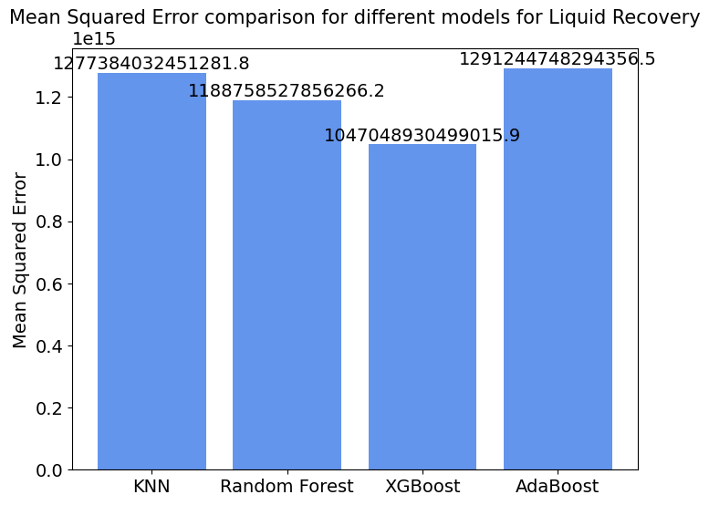
Results and Discussion from Regression
In predicting Liquid Recovery, the XGBoost performed best with lowest error than any other regression models

Slide 43
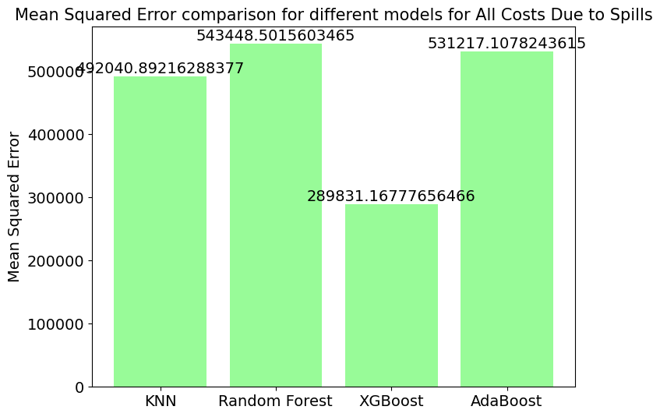
Results and Discussion from Regression
For predicting All costs due to spill, the XGBoost performed better than other models

Slide 44
Conclusion
For detecting oil spill, we have used datasets from Oil pipeline leak or spill documented by the DOT's Pipeline and Hazardous Materials Safety Administration which is USA based and Images of oil spill at sites in the Niger Delta region of Nigeria. We have also proposed different models that will give optimal accuracy.
To detect oil spill in different region of the world we can use these proposed models. Based on datasets the results might vary but the approach will be the same for all of them.

Slide 45
References
Oil Pipeline Accidents Data, 2010- 2017. Retrieved from: https://www.kaggle.com/datasets/usdot/pipeline-accidents on 5th May 2023.
Oil Spill Images. Retrieved from: https://www.kaggle.com/datasets/damingo1/spill-data on 3rd May 2023.

Slide 46
Thank You

